Slide 1
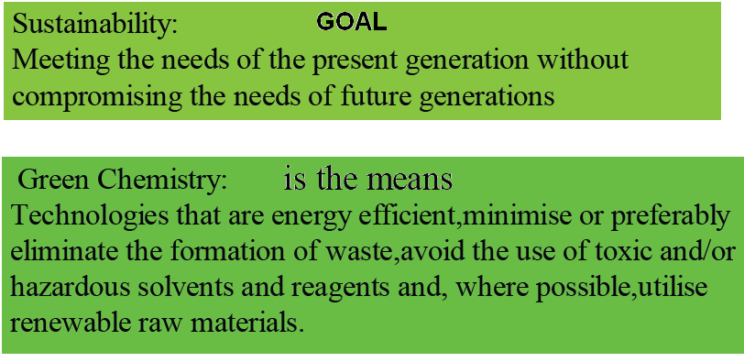
Green Chemical Processes

Slide 2
  GREEN CHEMISTRY IS ABOUT
  Waste Minimisation at Source
  Use of Catalysts in place of Reagents
  Using Non-Toxic Reagents
  Use of Renewable Resources
  Improved Atom Efficiency
  Use of Solvent Free or Recyclable Environmentally Benign Solvent systems
^{Waste}
^{Materials}
^{Hazard}
Reducing
^{Risk}
Energy
Cost

Slide 3
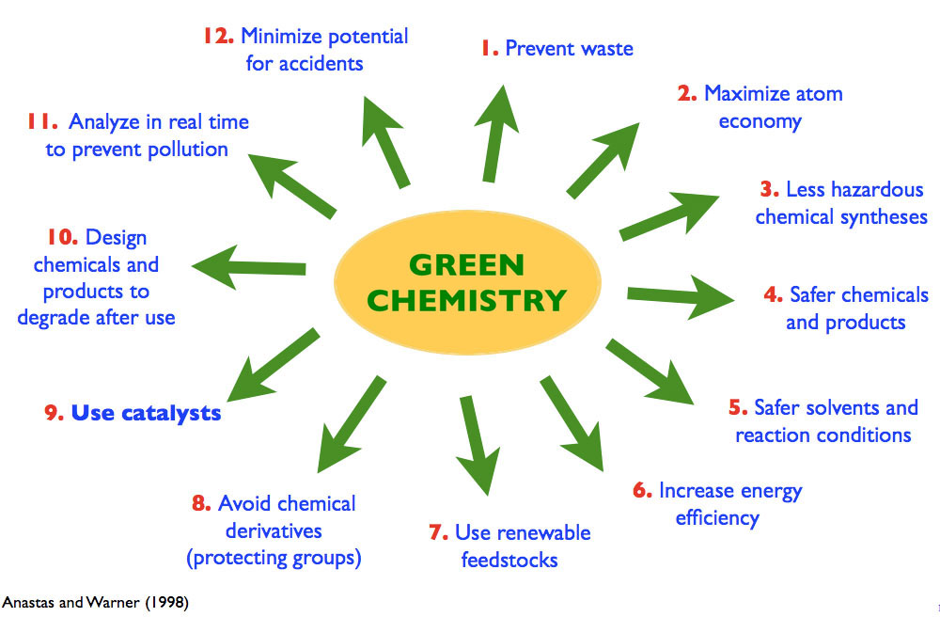

Slide 4

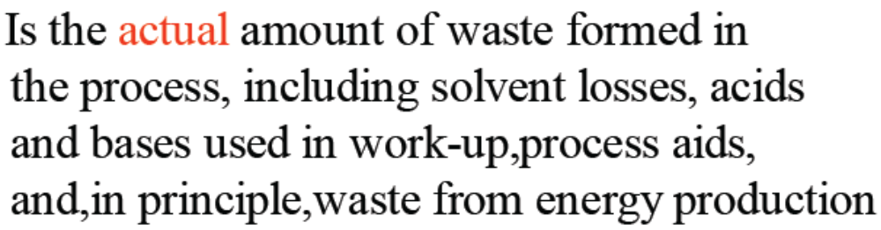
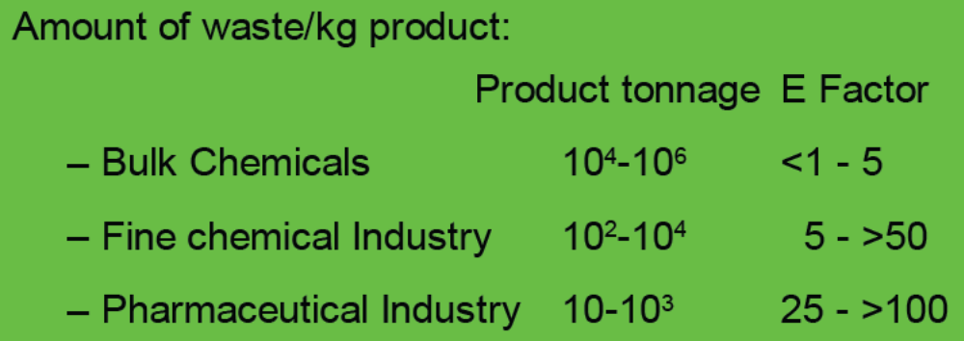

Slide 5
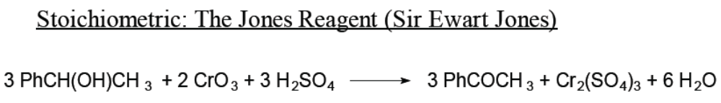








Slide 6
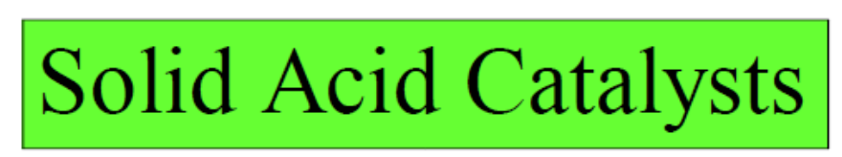
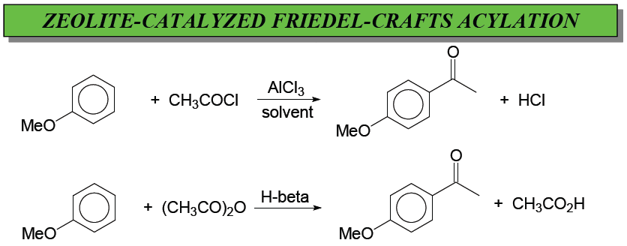

Slide 7
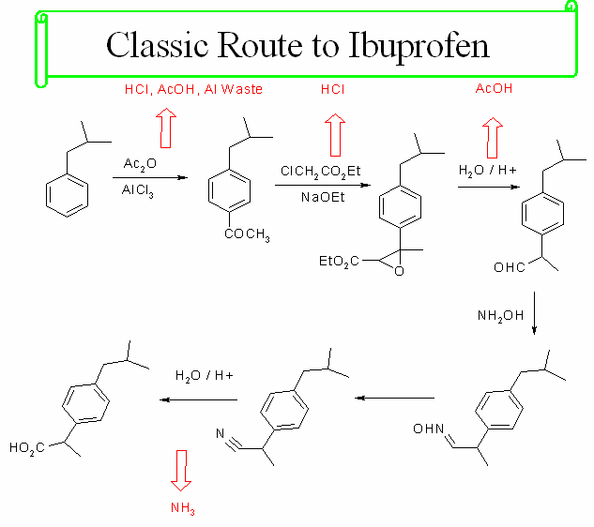

Slide 8
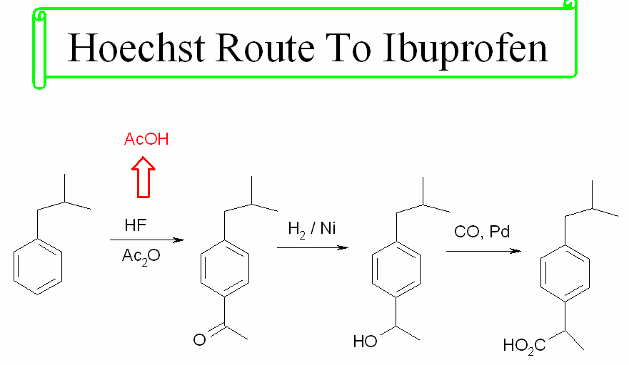
A Practical example of a Green Chemical Process

Slide 9

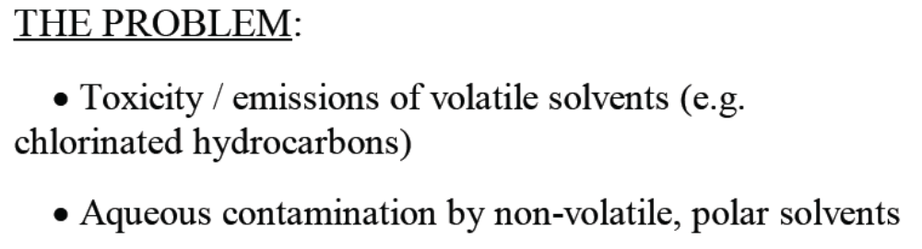
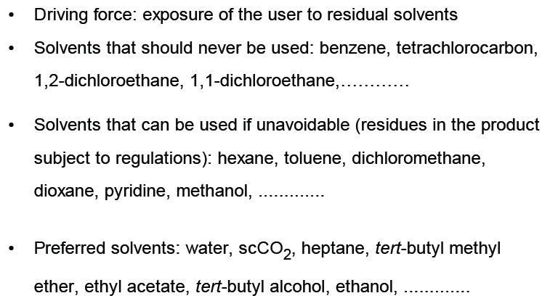
YES/NO About solvents

Slide 10

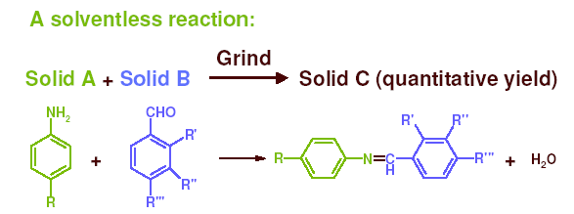
Low Toxicity
Easy Disposability (preferably no disposal)
Easy removal from product
Low reactivity
Nothing better than this…

Slide 11

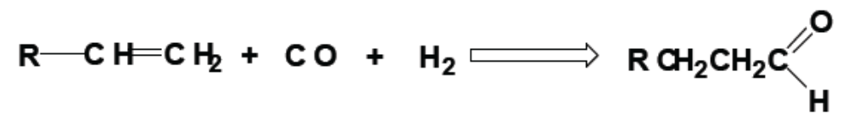
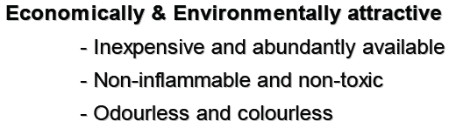


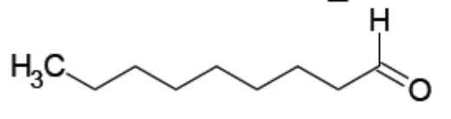


Slide 12
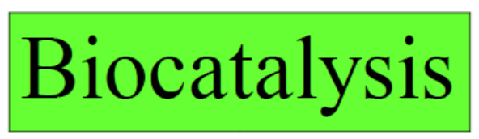
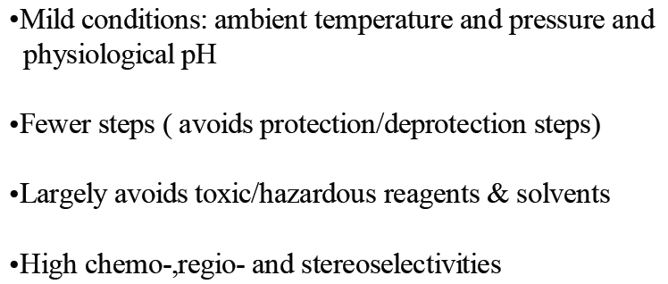
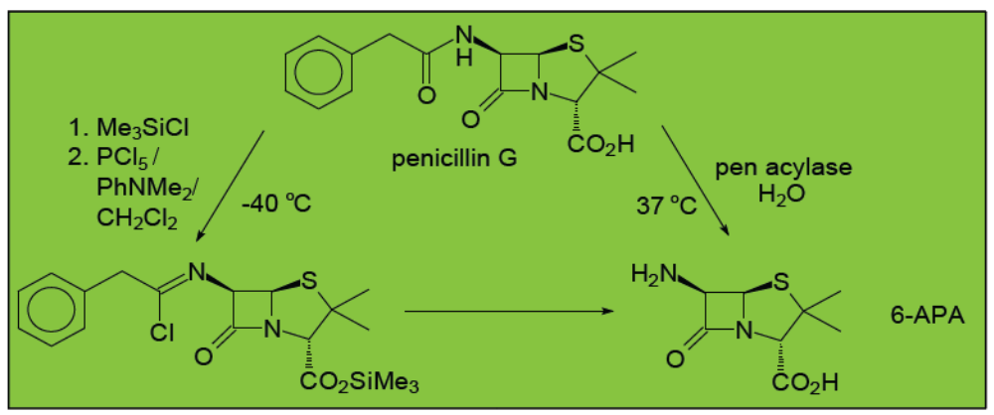

Slide 13
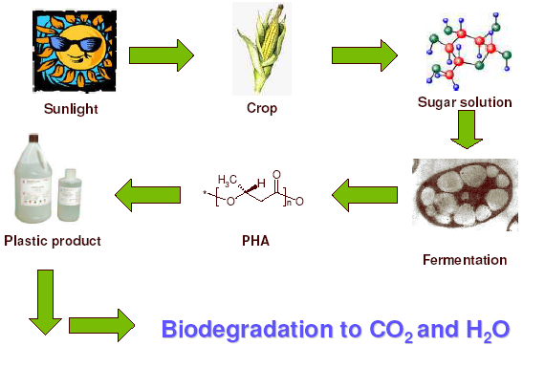
Biodegradable plastics: Polyhydroxyalkanoates (PHA’s)

